Slide 1
CHAPTER 2: MECHANICAL OSCILLATIONS

Slide 2
OVERVIEW:
Hooke’s law. Characteristics of a spring and damper.
Differential equation of a spring, mass and damper system and its solution.
Natural frequency. Forced oscillations. Frequency response of the system and resonance.
Damping and energy dissipation.
Application to vibration control and shock absorbers. Considerations for mechanical isolation of equipment. Magneto-rheological fluids and application to adaptive dampers.

Slide 3
MODULE 1 – SPRING MASS SYSTEM

Slide 4
HOOKE’S LAW
Hooke’s law, law of elasticity was discovered by the English scientist Robert Hooke in 1660, which states that, for relatively small deformations of an object, the displacement or size of the deformation is directly proportional to the deforming force or load.
Under these conditions the object returns to its original shape and size upon removal of the load.
Elastic behavior of solids according to Hooke’s law can be explained by the fact that small displacements of their constituent molecules, atoms, or ions from normal positions is also proportional to the force that causes the displacement.

Slide 5
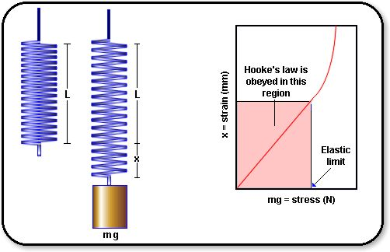
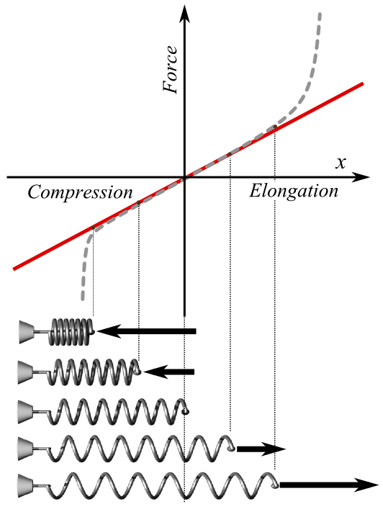
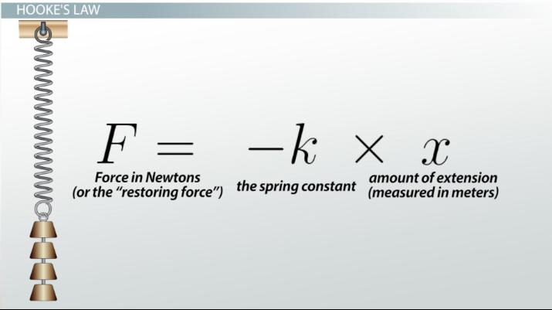

Slide 6
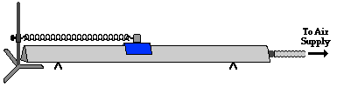
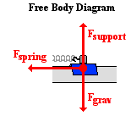
FORCE ANALYSIS OF A MASS ON A SPRING
The diagram shows an air track and a glider. The glider is attached by a spring to a vertical support. There is a negligible amount of friction between the glider and the air track. As such, there are three dominant forces acting upon the glider. These three forces are shown in the free-body diagram at the right.
The force of gravity always acts downward; its magnitude can be found as the product of mass and the acceleration of gravity (m•9.8 N/kg).
The support force (Fsupport) balances the force of gravity. It is supplied by the air from the air track, causing the glider to levitate about the track's surface.
The final force is the spring force (Fspring).

Slide 7
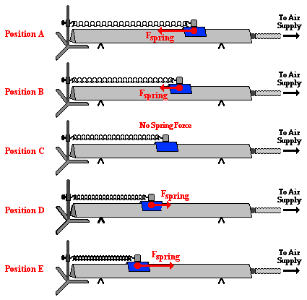
As the air track glider does the back and forth, the spring force (Fspring) acts as the restoring force. It acts leftward on the glider when it is positioned to the right of the equilibrium position; and it acts rightward on the glider when it is positioned to the left of the equilibrium position.
As the glider moves from position A (the release point) to position B and then to position C, the spring force acts leftward upon the leftward moving glider. As the glider approaches position C, the amount of stretch of the spring decreases and the spring force decreases, consistent with Hooke's Law.
At position C, the glider has reached its maximum speed. Once the glider passes to the left of position C, the spring force acts rightward. During this phase of the glider's cycle, the spring is being compressed.
The spring force acts as a restoring force, slowing the glider down as it moves from position C to position D to position E. By the time the glider has reached position E, it has slowed down to a momentary rest position before changing its direction and heading back towards the equilibrium position and spring force decreases

Slide 12
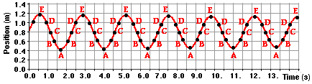
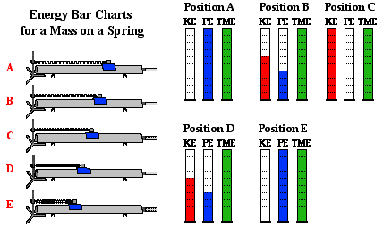
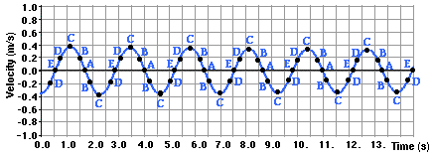
If a motion detector were placed at the right end of the air track to collect data for a position vs. time plot, the plot would look like the plot below. Position A is the right-most position on the air track when the glider is closest to the detector.
If the same motion detector that collected position-time data were used to collect velocity-time data, then the plotted data would look like the graph shown here.
You might recall from that discussion that positions A and E were positions at which the mass had a zero velocity. Position C was the equilibrium position and was the position of maximum speed.

Slide 13
OBSERVATIONS
1. Both position and velocity of the spring mass system varies sinusoidaly with time
2. The position-time and the velocity-time plots is shifted one-fourth of a vibrational cycle away from the other
3. Observe in the plot that the absolute value of the velocity is greatest at position C and velocity is zero whenever the position is at an extreme (A & E) when glider begins to change direction
4. Why is max velocity having a +ve and _ve sign?

Slide 14
Energy analysis of the spring mass system
The motion of the frictionless glider on the air track is given as follows. The glider will be pulled to the right of its equilibrium position and be released from rest (position A). As mentioned, the glider then accelerates towards position C (the equilibrium position). Once the glider passes the equilibrium position, it begins to slow down as the spring force pulls it backwards against its motion. By the time it has reached position E, the glider has slowed down to a momentary pause before changing directions and accelerating back towards position C. Once again, after the glider passes position C, it begins to slow down as it approaches position A. Once at position A, the cycle begins all over again ... and again ... and again.
The kinetic energy possessed by an object is the energy it possesses due to its motion. It is a quantity that depends upon both mass and speed. The equation that relates kinetic energy (KE) to mass (m) and speed (v) is
KE = ½•m•v²

Slide 15
The KE of the glider air track system
Stage of Cycle | Change in Speed | Change in Kinetic Energy
A to B to C | Increasing | Increasing
C to D to E | Decreasing | Decreasing
E to D to C | Increasing | Increasing
C to B to A | Decreasing | Decreasing
The other form is potential energy. Potential energy is the stored energy possessed by an object by virtue of its position. Elastic potential energy, refers to the position of the mass on the spring relative to the equilibrium position. For our vibrating air track glider, every time the spring is compressed or stretched relative to its relaxed position, there is an increase in the elastic potential energy. The amount of elastic potential energy depends on the amount of stretch or compression of the spring. The equation that relates the amount of elastic potential energy (PEspring) to the amount of compression or stretch (x) is
PE_{spring} = ½ • k•x²
where k is the spring constant (in N/m) and x is the distance that the spring is stretched or compressed relative to the relaxed, unstretched position.

Slide 16
When the air track glider is at its equilibrium position (position C), it is moving it's fastest (as discussed above). At this position, the value of x is 0 meter. So the amount of elastic potential energy (PEspring) is 0 Joules. This is the position where the potential energy is the least.
When the glider is at position A, the spring is stretched the greatest distance and the elastic potential energy is a maximum. A similar statement can be made for position E. At position E, the spring is compressed the most and the elastic potential energy at this location is also a maximum.
Since the spring stretches as much as compresses, the elastic potential energy at position A (the stretched position) is the same as at position E (the compressed position). At these two positions - A and E - the velocity is 0 m/s and the kinetic energy is 0 J

Slide 18
Period of a Mass on a Spring
The period is the time for a vibrating object to make one complete cycle of vibration. The variables that effect the period of a spring-mass system are the mass and the spring constant. The equation that relates these variables is
T = 2•Π•(m/k)^{1/2}
where T is the period, m is the mass of the object attached to the spring, and k is the spring constant of the spring.
The equation can be interpreted to mean that :
(i) more massive objects will vibrate with a longer period. Their greater inertia means that it takes more time to complete a cycle.
(ii) and springs with a greater spring constant (stiffer springs) have a smaller period; masses attached to these springs take less time to complete a cycle. Their greater spring constant means they exert stronger restoring forces upon the attached mass. This greater force reduces the length of time to complete one cycle of vibration.
Reference:
https://www.physicsclassroom.com/class/waves/Lesson-0/Motion-of-a-Mass-on-a-Spring

Slide 19
1. A 0.5 kg mass is hung on a vertical massless spring. The new equilibrium position of the spring is found to be 3 cm below the equilibrium position of the spring without the mass. What is the spring constant, k of the spring
K=f/x
=166 N/m

Slide 20
2. Consider a SHO with m = 0.5 kg, k = 10 N/m and amplitude A = 3 cm. a) What is the total energy of the oscillator? b) What is its maximum speed? c) What is the speed when x = 2 cm? d) What are the kinetic and potential energies when x = 2 cm?
TE: at x = 3cm
TE= PE
PE =1/2 kx²
=45 x 10⁻⁴ J
V:
Max KE = Max PE
½ mv² = ½ kx²
V2 = kx²/m
V = √kx² /m
= 0.134 m/s
V at x=2 cm:
0.10 m/s
TE = KE + PE ( at x=2 cm)
45 x10⁻⁴= 1/2mv² + ½ k(2x10-2)²
PE & KE at x=2 cm
PE = 20 x 10-4 J
KE = 25 x 10-4 J

Slide 21
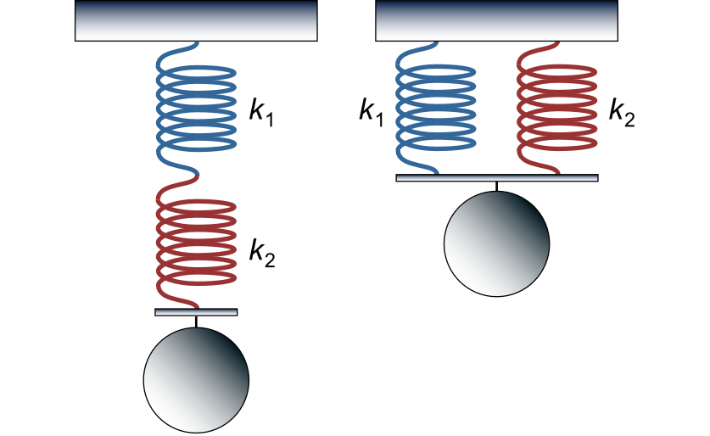
SPRING CONNECTED IN SERIES AND PARALLEL
In the case of series connection, the elastic force in each spring is equal to the force of gravity (without taking into account the weight of the springs). The total extension is the sum of the extensions of each spring:
Total Extension is:
X =X₁ + X₂
Then the equivalent stiffness is given by
F /k= F/k₁ + F/k₂
1/k = 1/k₁ + 1/k₂
1/k = (k₁ + k₂)/(k₁.k₂)
k = (k₁.k₂)/(k₁+k₂)
Time Period is:
T = 2π√(m/k)
= 2π√(m(k₁+k₂))/k₁.k₂)

Slide 22
When connected in parallel, the extension of both springs is the same, and the total elastic force will be equal to the sum of the forces in each spring:
Total Extension is:
X =X₁ = X₂
The total elastic force is given by
F= F1 + F2
kx = k1x1+ k2x2
Since x = x1 = x2
k = (k1 +k2)
Time Period is:
T = 2π√(m/k)
= 2π√(m/ (k1 +k2))

Slide 23
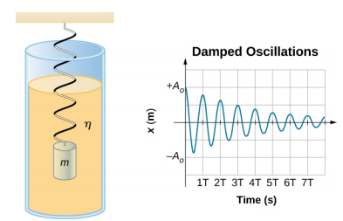
Damped oscillations
The figure shows a mass m attached to a spring with a force constant k. The mass is raised to a position A₀, the initial amplitude, and then released.
The mass oscillates around the equilibrium position in a fluid with viscosity but the amplitude decreases for each oscillation. For a system that has a small amount of damping, the period and frequency are constant and are nearly the same as for SHM, but the amplitude gradually decreases as shown. This occurs because the non-conservative damping force removes energy from the system, usually in the form of thermal energy
Contributors and Attributions:
Samuel J. Ling (Truman State University), Jeff Sanny (Loyola Marymount University), and Bill Moebs with many contributing authors. This work is licensed by OpenStax University Physics under a Creative Commons Attribution License (by 4.0).

Slide 24
3. If the mass in the above problem experiences a constant frictional force of 0.1 N and is released from rest at x = 3 cm, what is the velocity of the mass when it first passes through the equilibrium position at x = 0?
-F_{r}.x = (KEf-KEi) + (PEf- PEi)
= (½ mvf² – 0) + (0 – 1/2kx²)
V_{f} = 0.077m/s
New TE = ½ mv^{2 = 15 x 10-4 J}
Energy lost due to friction = (45x10⁻⁴ – 15x10⁻⁴ )
^{= 30 x 10-4 J}

Slide 26
Three objects A, B and C are kept in a straight line on a frictionless horizontal surface. These have masses m, 2m and m, respectively. The object A moves towards B with a speed 9 m/s and makes an elastic collision with it. Thereafter, B makes completely inelastic collision with C. All motions occur on the same straight line. Find the final speed (in m/s) of the object C.
Ans:
Apply
Conservation of momentum
and energy
Vb = 6 m/s
2. Apply conservation of momentum
Vc = 4 m/s

